Slide 1
Assessing Market Penetration to Drive Business Outcomes
Kevin King PBS
Branch 95 (El Dorado Hills)
December 8, 2022

Slide 2
Background
SIR has seen a steady decline in the number of branches over the years
Each branch closure has the potential for a permanent loss of members
Numerous new programs and tools designed to reverse course are helpful and necessary but may not have a timely and impactful effect on membership numbers
Branch sustainability and growth depends on a new set of market-oriented processes and tools
These same processes and tools may also help decisionmakers in identifying areas for new branch locations

Slide 3
Common Reasons Why Branches Fail and Associated Remedies
Declining membership over an extended period of time (from a 2013 study) – eliminated requirement to be retired and lowered age to 50; branding; social media (Facebook); community service; marketing/publicity campaigns; potentially allowing women to join
Too few activities – State Activities Chairman is actively involved in assisting branches in developing new activities and/or promoting shared activities with nearby branches
Attrition due to the aging of our branch members – lowering age; allowing women
Uninteresting monthly programs – implementation of statewide Speakers Exchange
Lack of volunteers to fill key positions – expanded training program; new Account Representative replacing Regional Directors and Area Governors

Slide 4
Overview of the Market Penetration Analysis
17 branches (8 East Bay branches along the 24 - 680 corridors, 5 in the Sacramento region, 2 North Bay, 1 Peninsula and 1 Central Valley) were examined using the State Roster dated 10/31/22 and membership data from Constant Contact as of 11/2022
To determine where a branch drew a majority of its members, zip codes for the top 80% of branch members were captured using Constant Contact data
The pool of potential members was determined by accumulating the number of men 50+ (the pool of potential members) from those zip codes using readily available online data
A branch's market penetration was calculated by dividing its current membership by the pool of potential members
Based on zip code, market participation was also calculated by dividing the sum of members across multiple branches having that zip code by the pool of potential members

Slide 5
Summary of the Results
A typical branch, attracts less than 1% of men 50+ from the zip codes in which it draws the majority of its members; the average for all branches in the study was 0.5% or 1 member for every 200 eligible men
Branches with the highest market penetration (1.4% - 2.4% which included 4 of the 17 branches studied) attracted only 3-5 members for every 200 eligible men
Nearly 400,000 men aged 50+ live in 80 zip codes from which all branches in my study draw the majority of their 2,300 members for a market penetration, based on zip code, of 0.6%
The zip code with the highest market penetration (94598 in Walnut Creek) accounted for 197 members spread across the four branches in the Walnut Creek-Concord area; the pool of men 50+ from this zip code is 5,312 for a market penetration of 3.7% or approximately 7 members for every 200 men; only 16 of 80 zip codes had market penetrations greater than 1.0%

Slide 6
What’s It All Mean?
There’s a huge, untapped pool of potential members
We need to better understand the key differentiators of branches or zip codes whose market penetration is higher than 1% and why 1% seems to be a ceiling for the majority of branches studied. Some factors may include:
Geographically concentrated vs. diverse, as determined by number of zip codes a branch draws from
Having a common interest such as boating or RVing to build off of
Being big and having a lot of activities does not seem to be enough as many of our branches with 180+ members still only had market penetrations in the 0.4% - 0.7% range
A small branch with very few activities can have a high market penetration (2.4%) if they are in a unique geographical area and/or have built their branch around a common interest such as golf, boating, RVing, etc.
Available processes and tools to attract new members may not be enough; coordinated branch and State marketing/publicity and other processes/tools may be required to increase SIR overall market penetration

Slide 7
Open Questions for Further Discussion
Should market penetration be added to the list of why branches fail?
What’s a reasonable market penetration goal against which a branch will be measured?
What does a branch’s market penetration say about its overall health? When is State assistance or intervention required?
What branch and State processes/tools/programs are currently in place or need to be developed to increase a branch’s and SIR’s overall market penetration?
What potential branch size is sufficient to approve a new branch or should State assist an existing, nearby branch in extending their marketing/publicity to recruit in that area?
What is the membership growth potential of expanding the SIR footprint into Southern California?

Slide 8
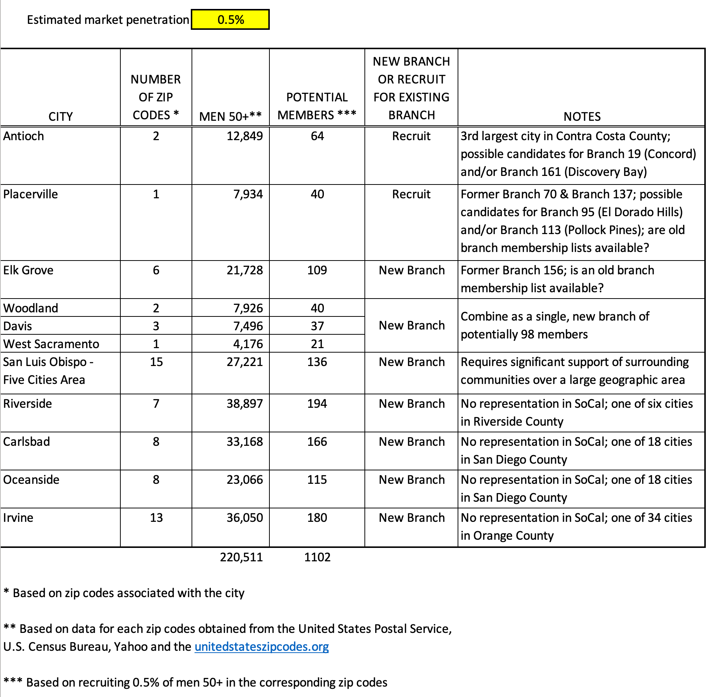
Underserved Cities with a Potential of Generating Membership Growth

Slide 9
Next steps
Q & A
For more information about this analysis or additional results for your branch, contact Kevin King at kmking00@gmail.com

